Slide 1
Deploying web applications in a multi-cloud environment using CI / CD process
DevOps Project
Volodymyr Verholyak
EPAM [OnlineUA] Summer 2020

Slide 2
what I'm trying to solve ?
- How to build a user-friendly CI / CD process?
- How to build an environment for project deployment
- Which technology is most appropriate for the project
- how to make it cheaper
- How to make a high availability service

Slide 3









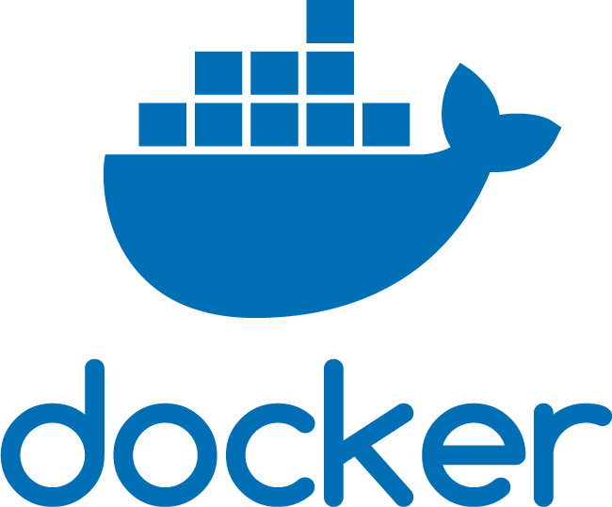
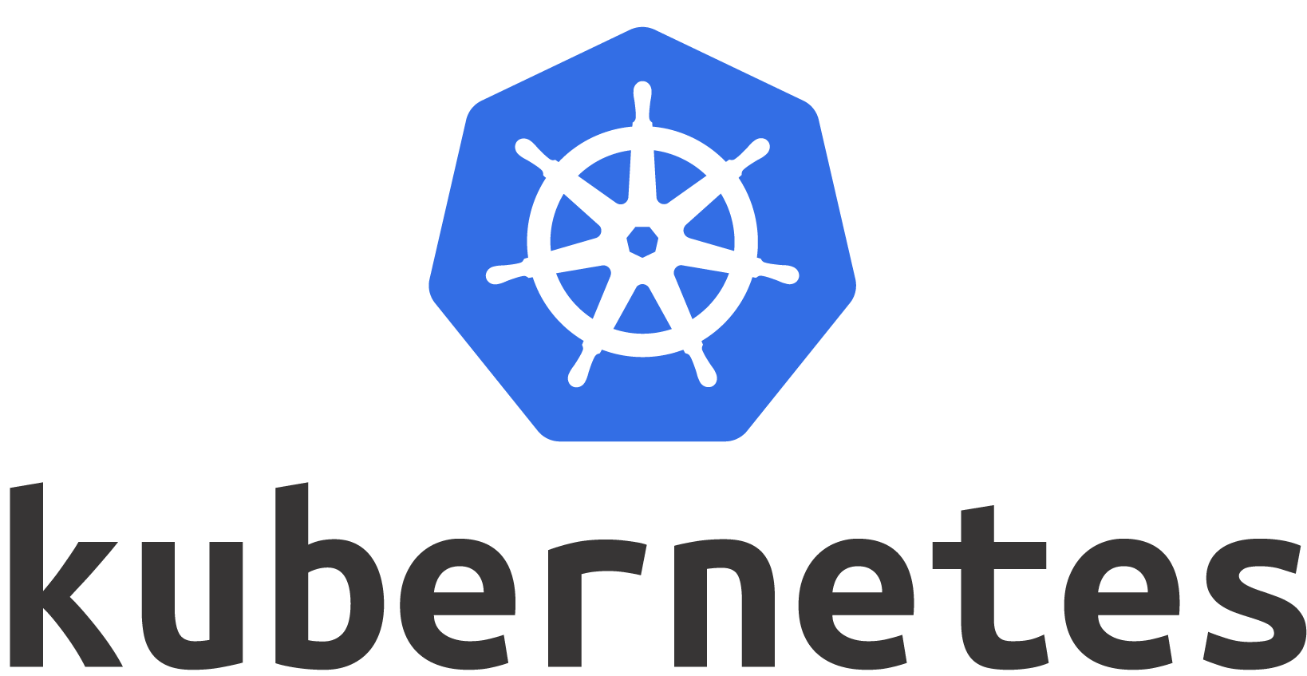


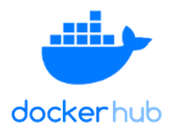




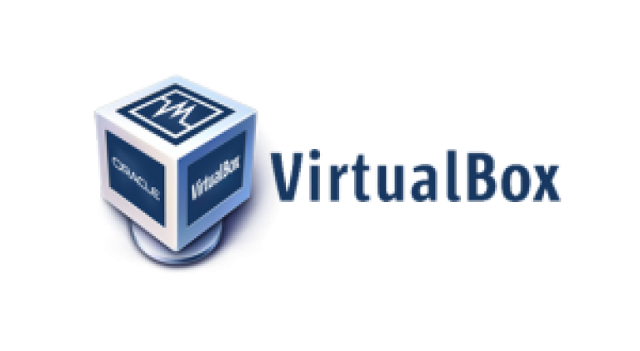
Used tools and services
Cloud Provider:
Operationtions System:
Automation:
Bucket secret:
Integration:
Containers:
Cluster Manager:
Web Servers:
Build:
Monitoring:
Testing:
Virtualizations:

Slide 4



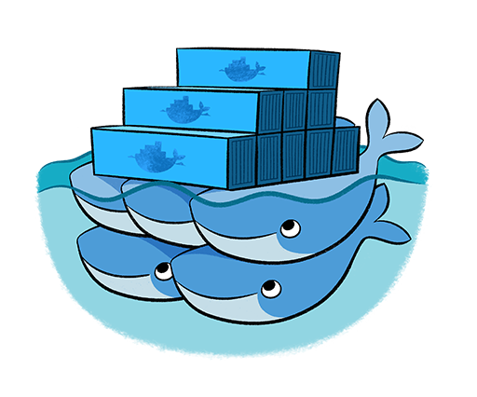
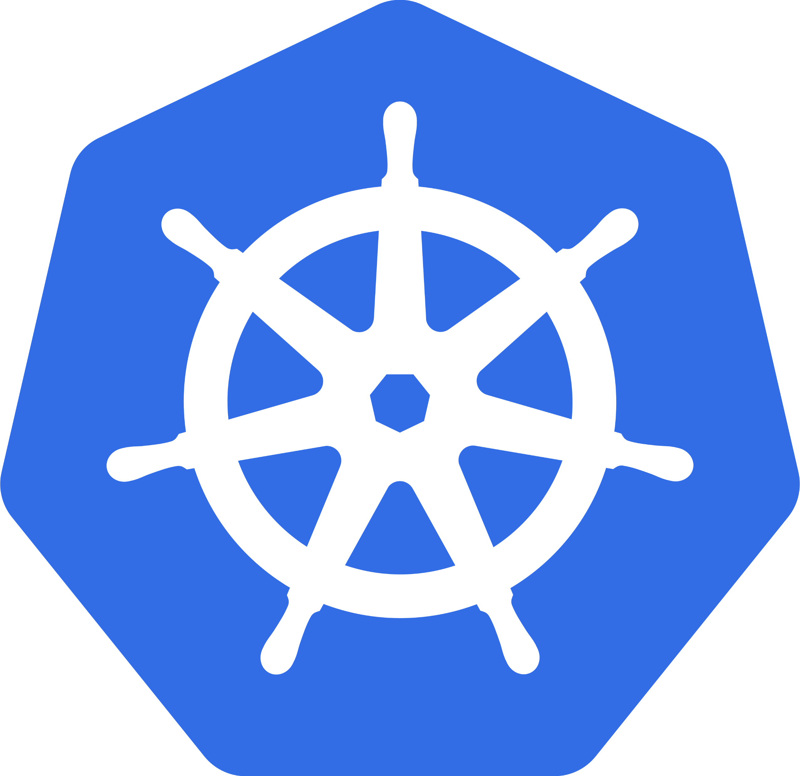
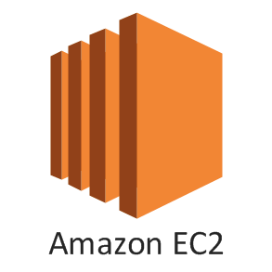
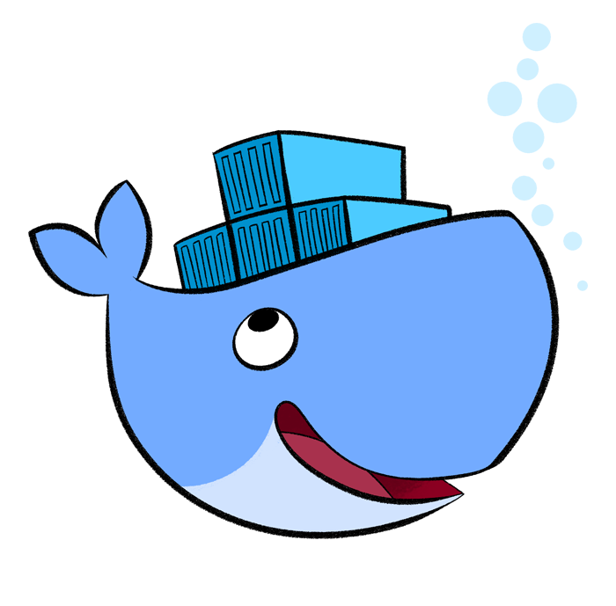
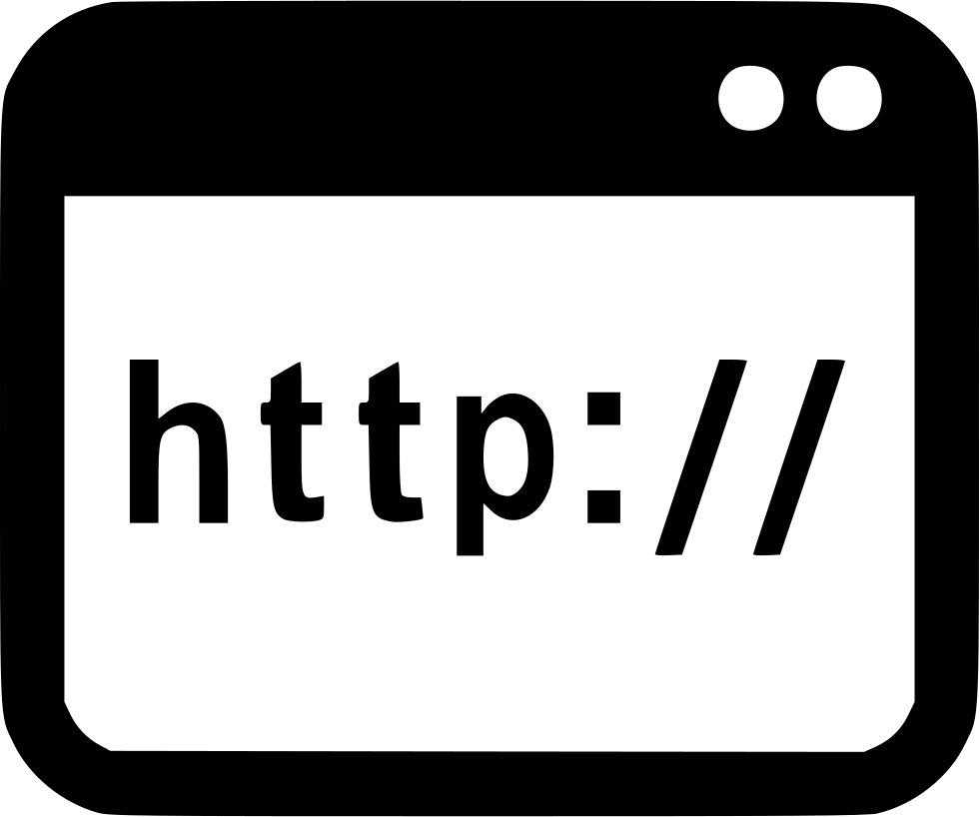










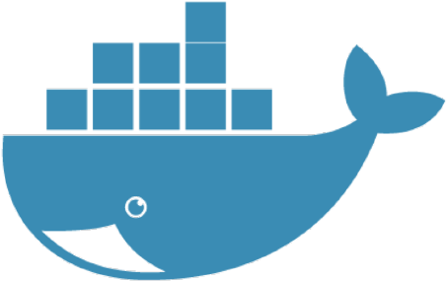


CI / CD process
Development
Staging
Production
kubernetes
blue/green
zero downtime
developer
test environment
minitoring
users
webhook
playbook
config.tf
hub
backend
customer
docker

Slide 5
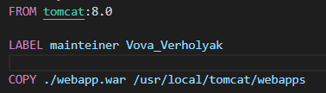
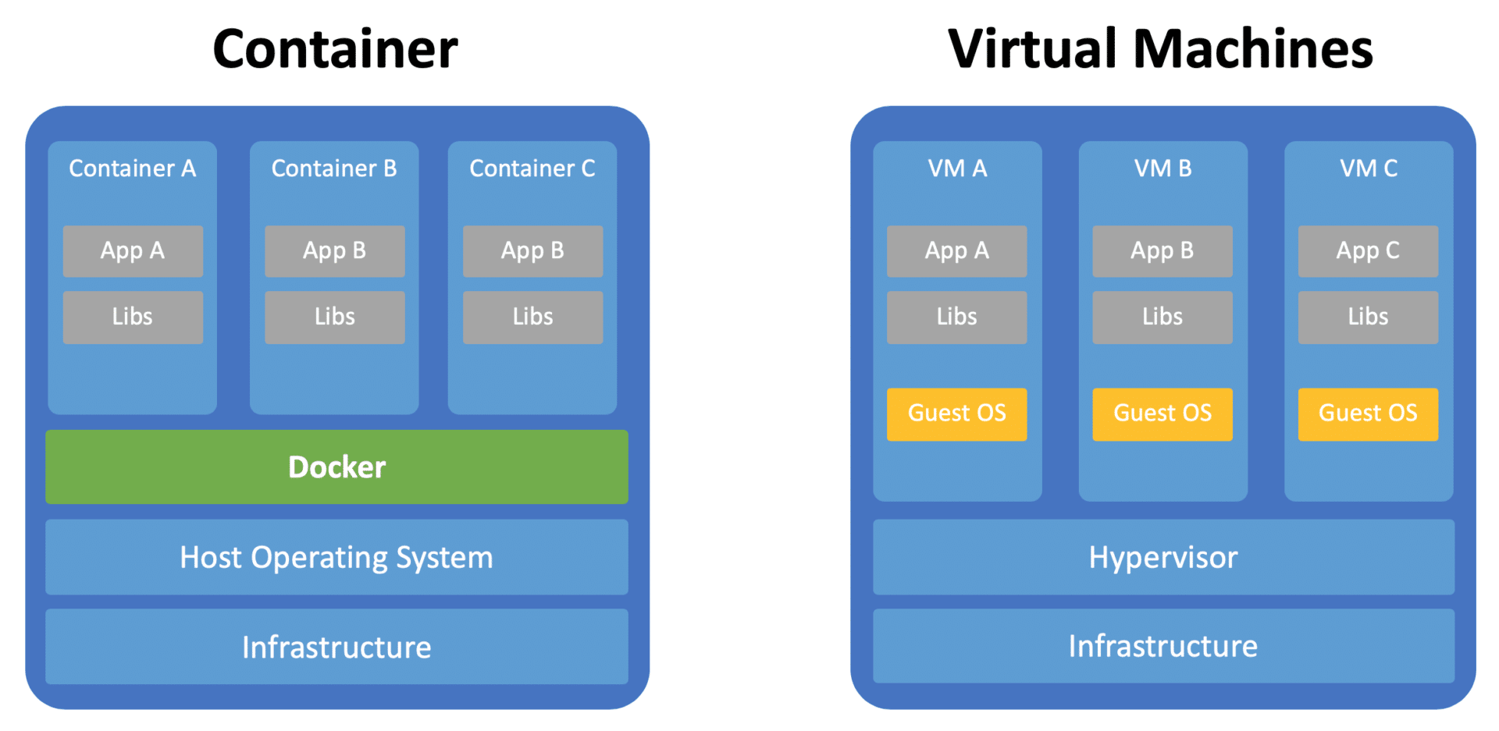
A few words about: Docker Container and VM

Slide 6
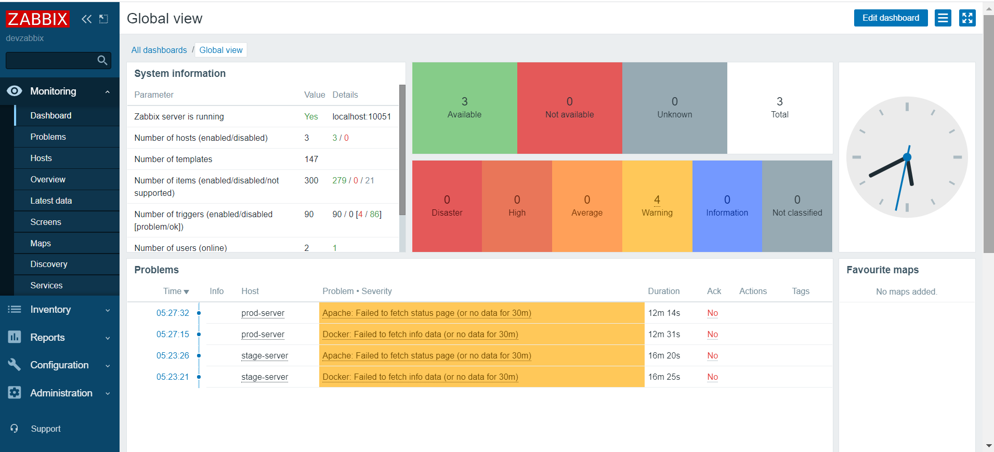
Zabbix monitoring

Slide 7
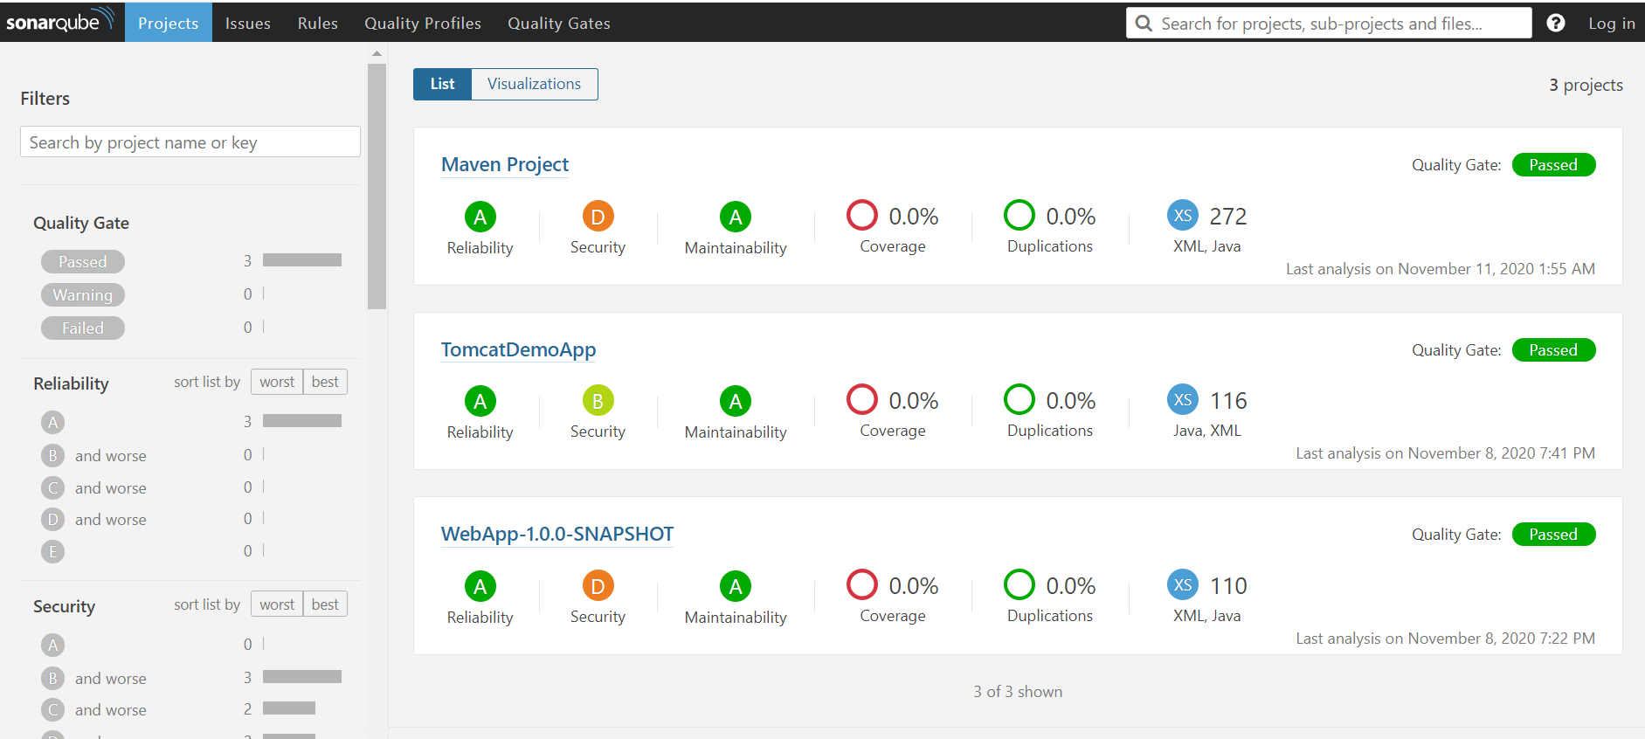
SonarQube test

Slide 8
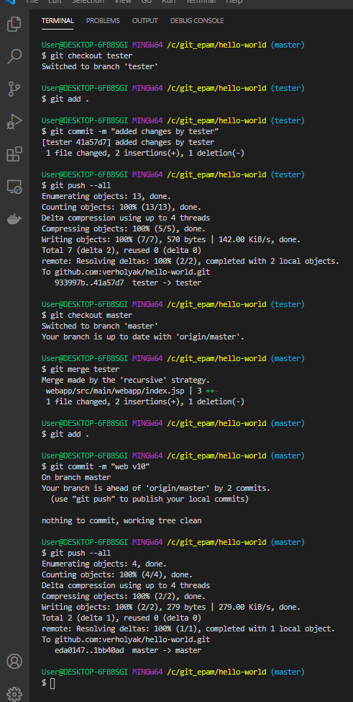
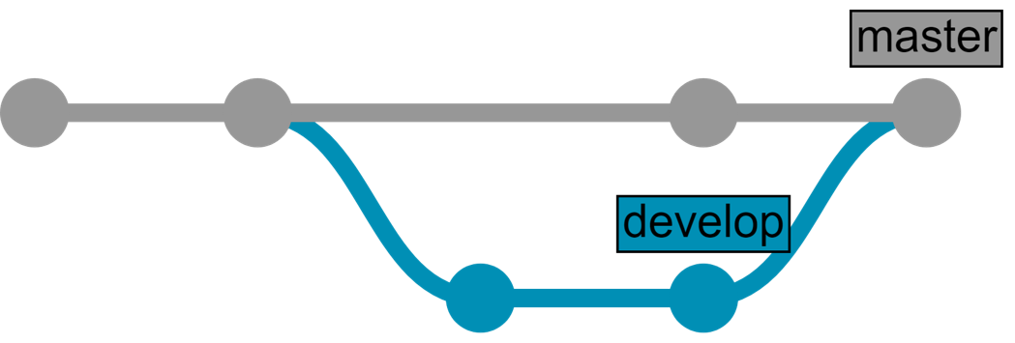
Step 1. Deploy code or changes
Developer wants to make some changes to the code and he wants to see the changes → let's start !!!
Webhook to Jenkins →

Slide 9
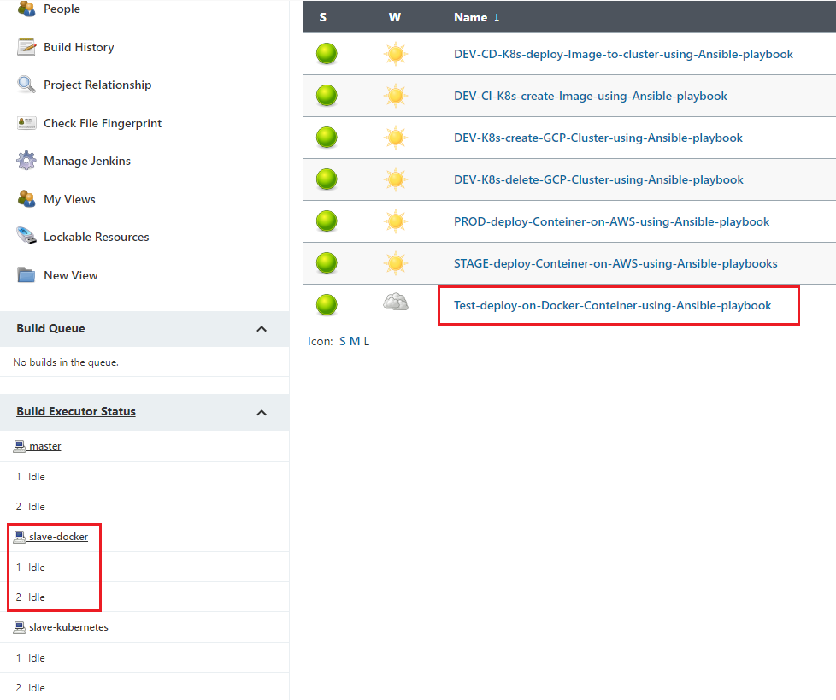
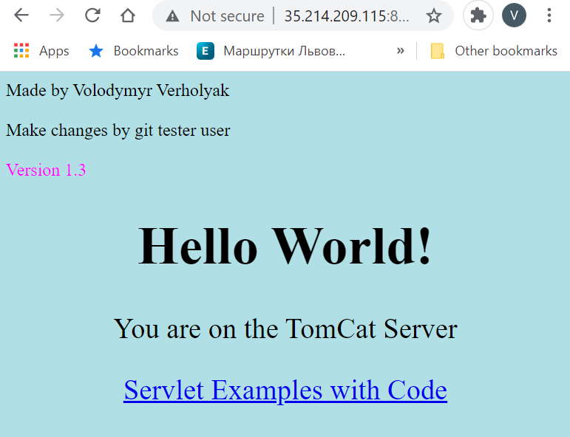
Step 2. Deploy to Docker Dev-Server using Ansible playbook
what I used here:
GitHub webhook and services ngrok
Maven, SonarQube test
Create artifact “webapp.war” file
Ansible playbook, create image and push to DockerHub repository
Ansible playbook, deploy image from DockerHub repository to Dev-Server
Use GCP cloud provider
http://35.214.209.115:8081/webapp/
Deploy to Kubernetes →

Slide 10
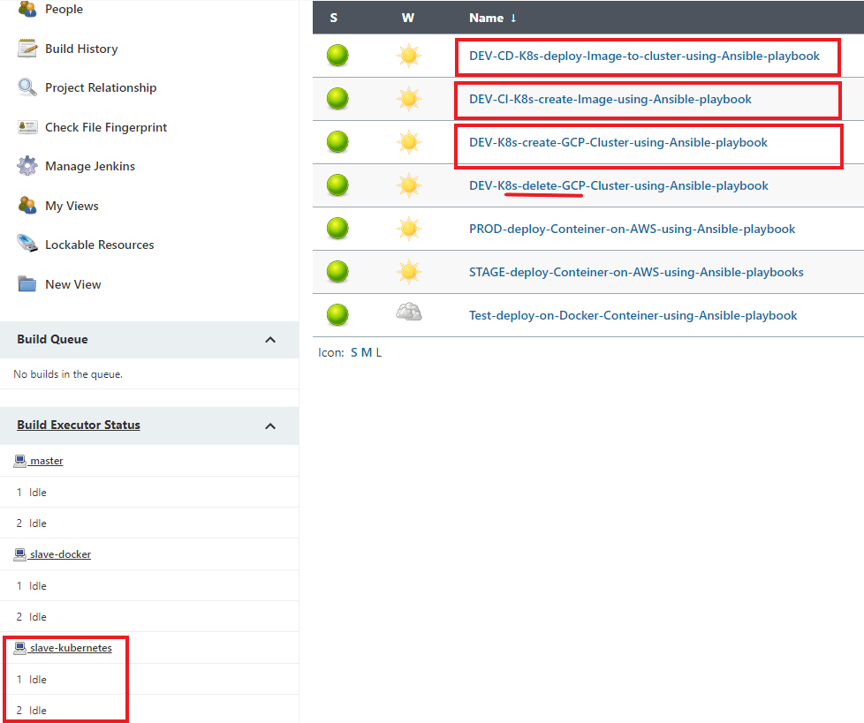
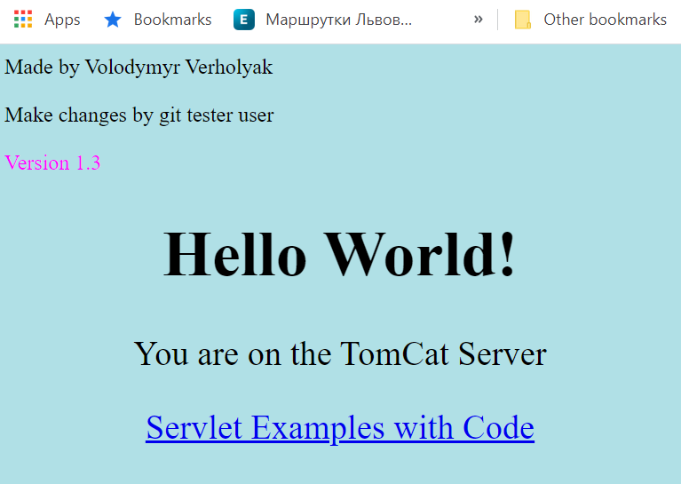
Step 3. Deploy changes to Kubernetes from Jenkins job (manual)
what I used here:
Maven, SonarQube test
Create artifact “webapp.war” file
Ansible playbook, create Kubernetes Cluster, using parameters
Ansible playbook, create image and push to DockerHub repository
Ansible playbook, deploy image from DockerHub repository to Kubernetes Cluster using yaml config
Use GCP cloud provider
http://35.204.36.248:8081/webapp/
Deploy to STAG using Jenkins →

Slide 11
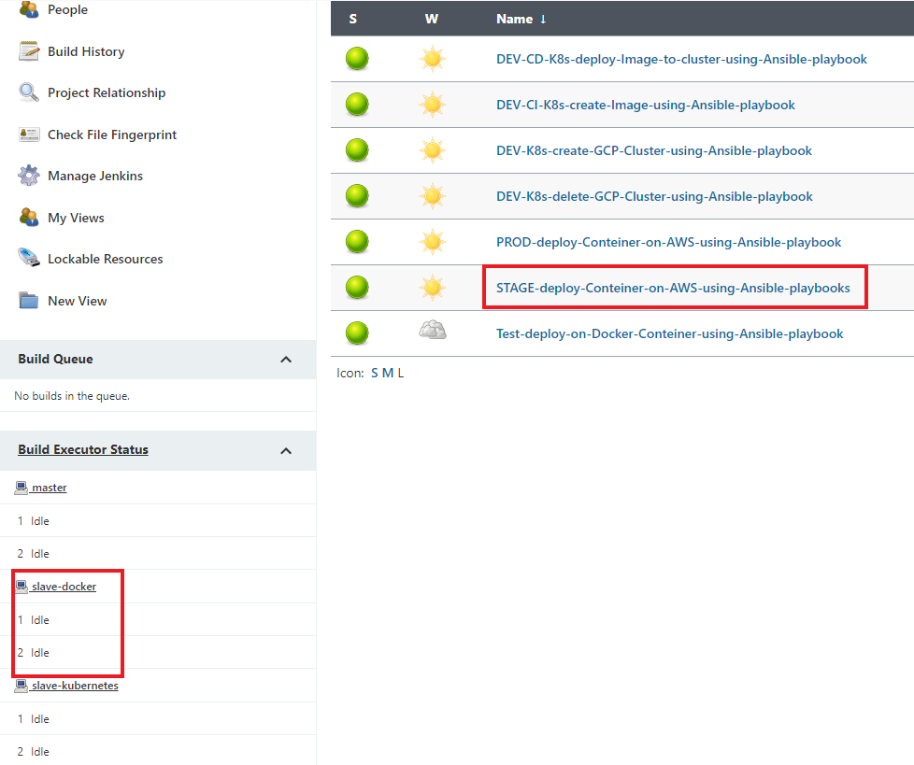
Step 3. Deploy to STAGE WebServer using Jenkins job (manual)
what I used here:
Maven, SonarQube test
Create artifact “webapp.war” file
Ansible playbook, create image and push to DockerHub repository
Ansible playbook, deploy image from DockerHub repository to STAGE-Server
Use AWS cloud provider
http://18.198.63.214:8081/webapp/
Deploy to PROD using Jenkins →

Slide 12
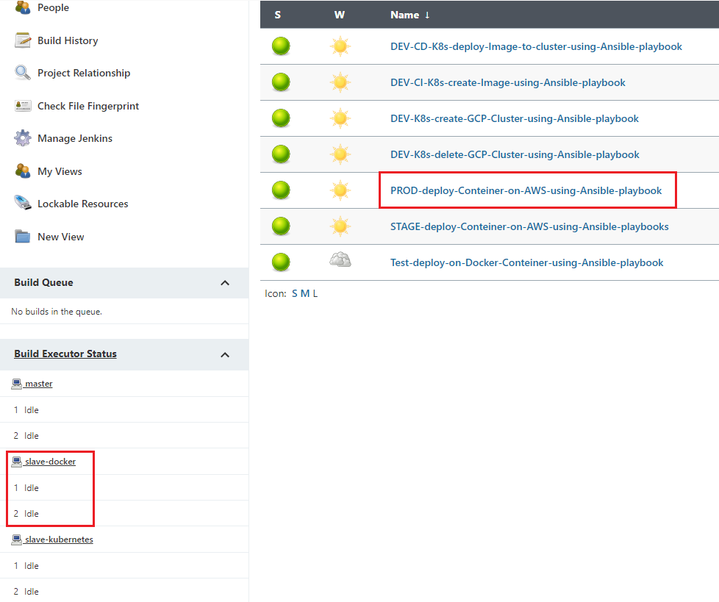
Step 4. Deploy to PROD WebServer using Jenkins job (manual)
what I used here:
Maven, SonarQube test
Create artifact “webapp.war” file
Ansible playbook, deploy image from DockerHub repository to STAGE-Server
Use AWS cloud provider
http://18.159.26.114:8081/webapp/
Deploy to DEV using Jenkins →

Slide 13
developer, customer and users are happy because their service works well :)

Slide 14
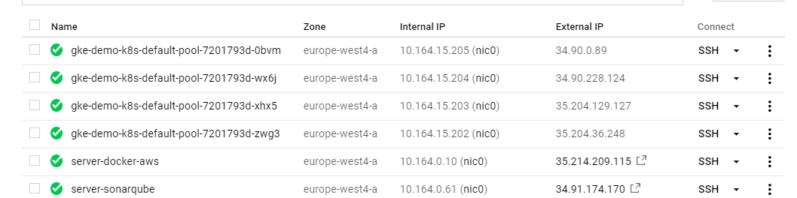
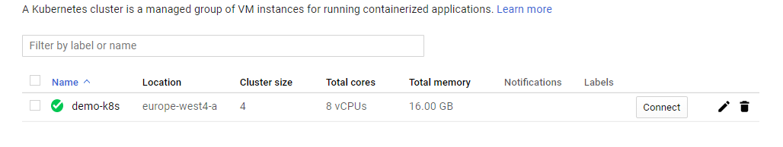
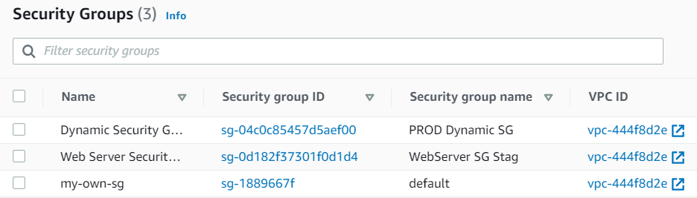
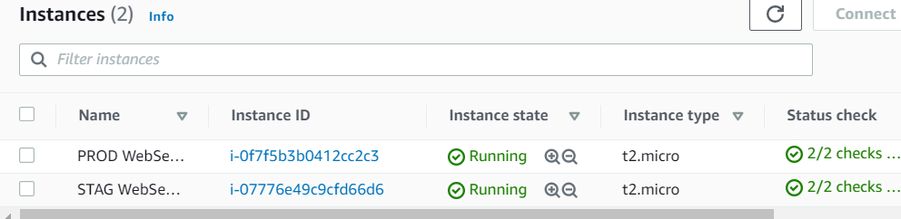
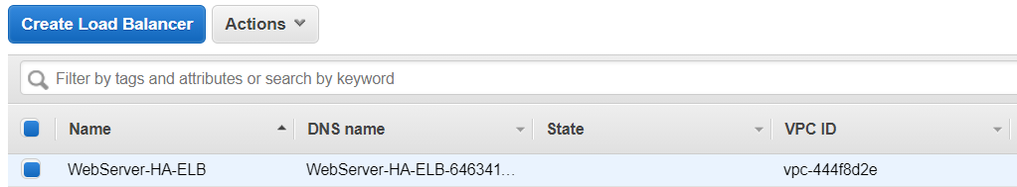
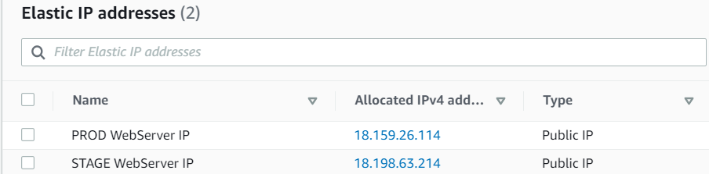
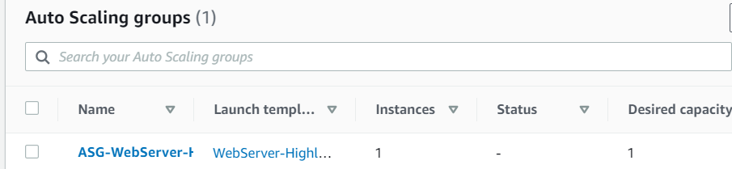
Infrastructure in pictures

Slide 15
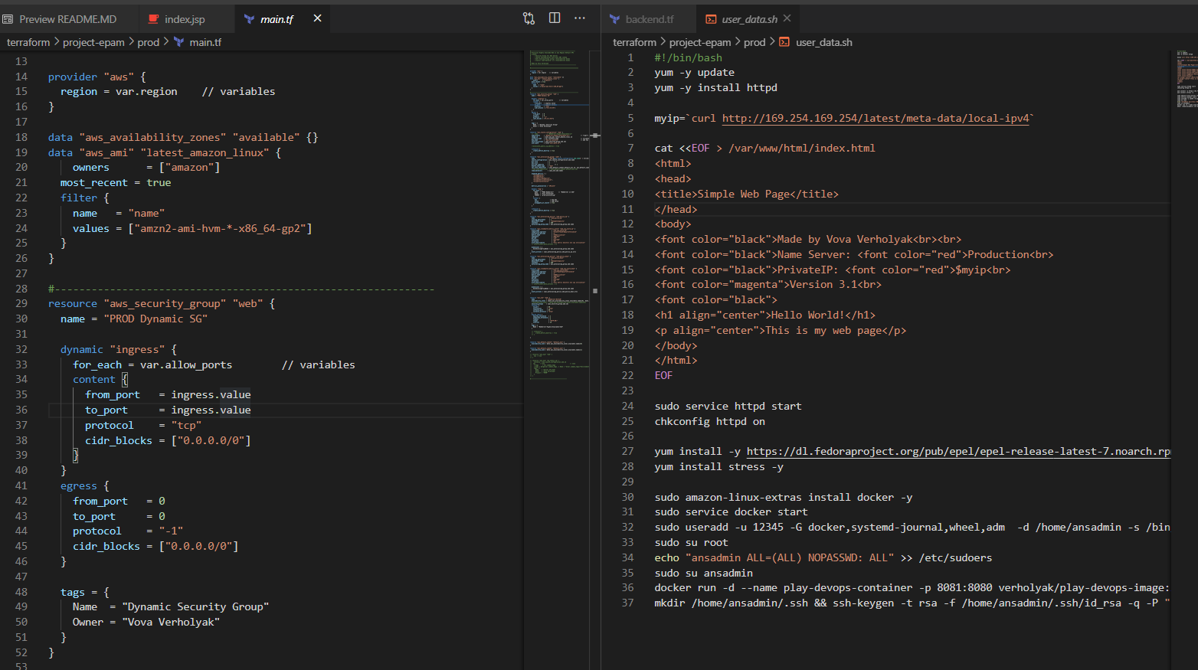
Terraform: infrastructure as code
This is only a part of the code, you can see the whole project source code in my private repository by following the link: https://github.com/verholyak/Epam_External_Project

Slide 16
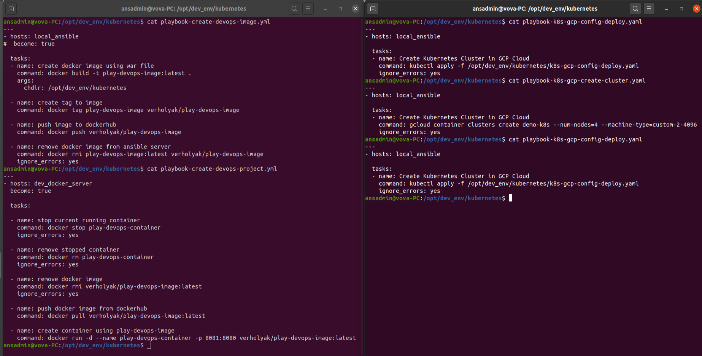
Ansible playbook

Slide 17
DEMO

Slide 18
Question ?

